Slide 1
Vending Machine
Informal Specification

Slide 2
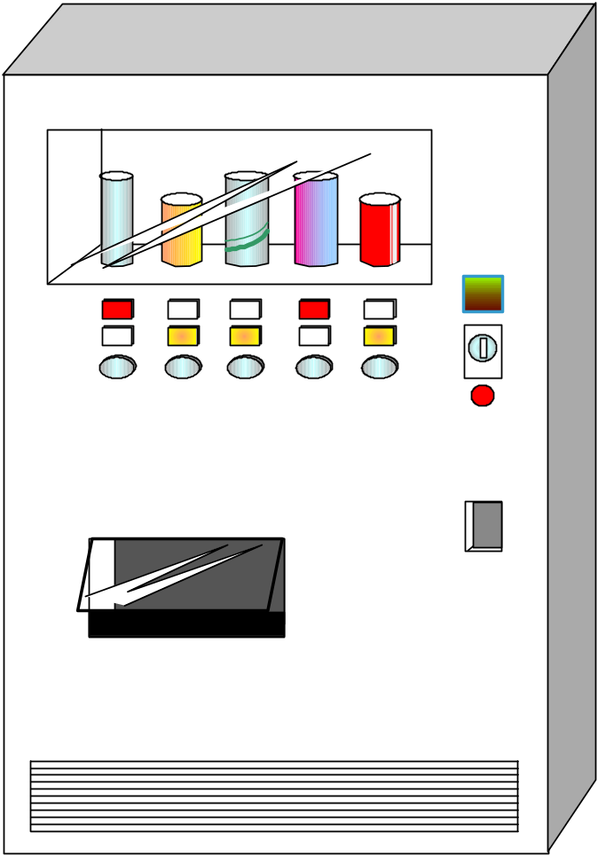
Appearance of the Vending Machine
Merchandize Display
Sold Out Light
Amount Display
Purchasable Light
Coin Inserter
Purchase Button
No Change Light
Coin Return
Can Delivery Bin

Slide 3
Specification of the Vending Machine
We consider only the use-cases of the customer (actor)
Specification
  It can provide customers with N kinds of drinks
  A customer can use 10, 50, 100 Japanese yen coins
  If the number of any of the 10 yen, 50 yen, or 100 yen coins becomes below X, Y, or Z, respectively, it turns on the “No Change Light”
    When “No Change Light” is on, VM’s coin blockers are set and VM does not accept any coin
  A customer can buy only one can at a time
    Once a customer buys one can, it returns the change if any

